Slide 1

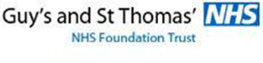
Dr. Marius Terblanche | Clinical Consultant in Critical Care Medicine, Guy’s & St. Thomas’ NHS Foundation Trust, London, UK | @mterblance2 @GSTT_ICU

Slide 2











Slide 3



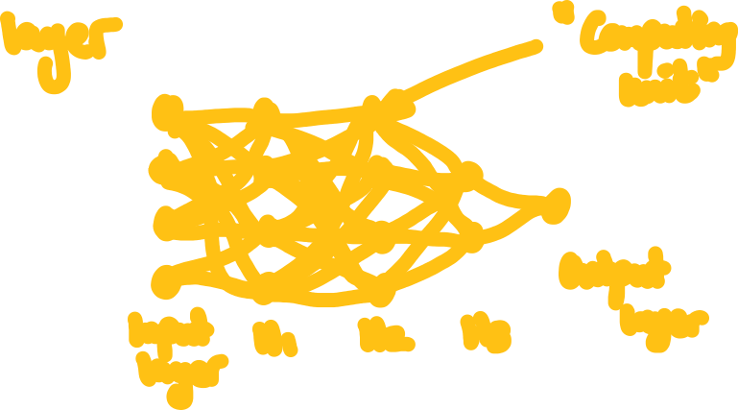

Slide 4
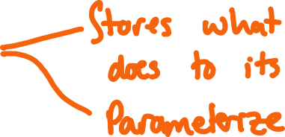








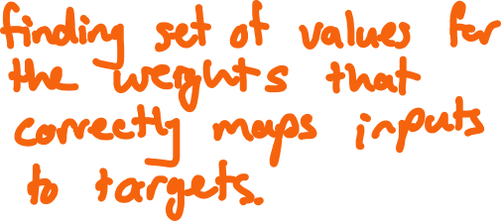

Slide 5

















Slide 6
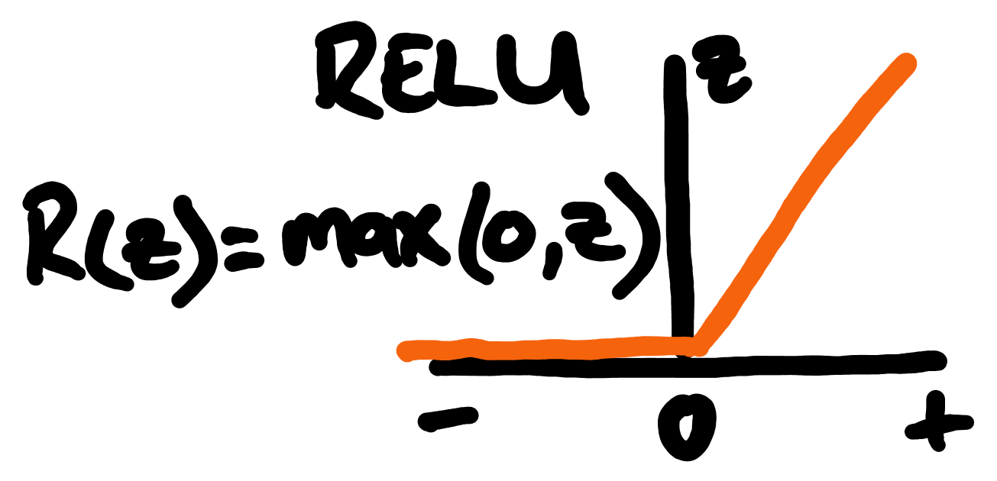
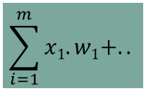
Math heavy lifting inside each ‘neuron’…
Inputs
Weights
X₁
W₁
Activation function
Node
X₂
W₁
$$\sum_{i=1}^{m}{x1.w1+..}$$
Nett input
Output
X₃
W₃
Process summation
X₄
W₄
Y = f(X)

Slide 7
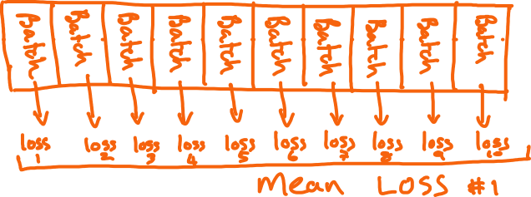










Slide 8










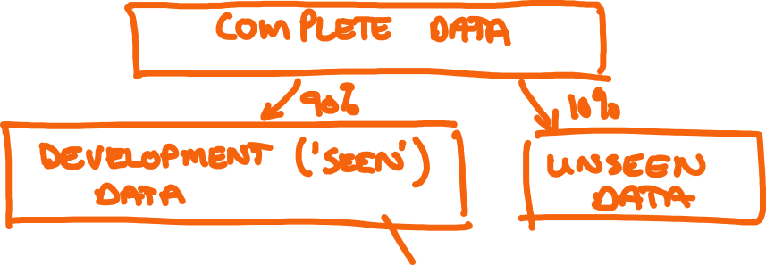

Slide 9


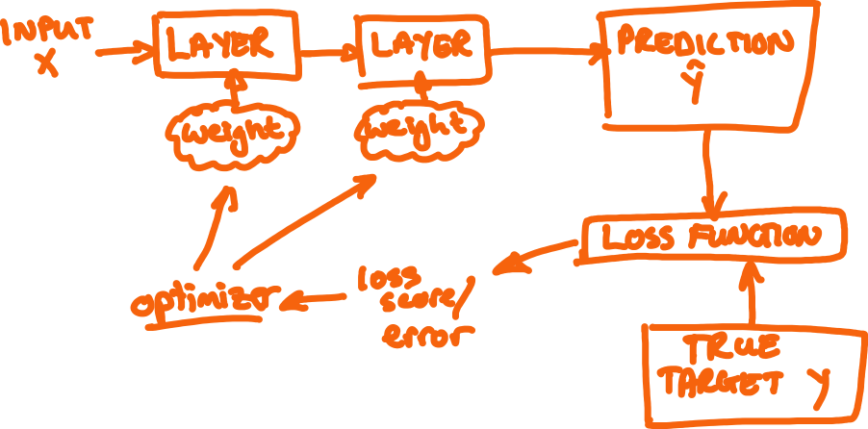





Slide 10



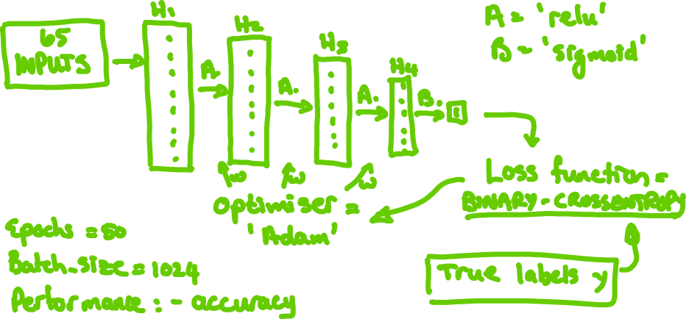


Slide 11
















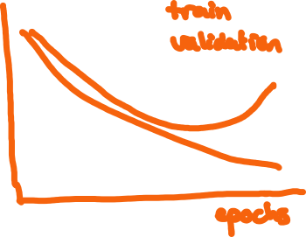


Slide 12


